Slide 1

MAHENDRA ENGINEERING COLLEGE (Autonomous)
CATCH ‘25 – Hackathon
Name of the College : Mahendra Engineering College
Name of the Team : Team Ascenders
Name of the Team Leader : Arun A
Name of the Department : Aeronautical Engineering
Problem Statement : Stratospheric Dust Analysis Rocket
Date : 17.03.25

Slide 2
CREW DETAILS
NAME OF THE STUDENT | YEAR | DEPARTMENT | DESIGNATION | E MAIL ID
ARUN A | II Year | AERONAUTICAL | STUDENT | arunaru0813@gmail.com
ARAVINTH D | II Year | AERONAUTICAL | STUDENT | intharavinth@gmail.com
ANTONY LOURD MARY T | II Year | AERONAUTICAL | STUDENT | angeltenison2006@gmail.com
THIRUMAL V | II Year | AERONAUTICAL | STUDENT | thirumal.v1311@gmail.com

Slide 3

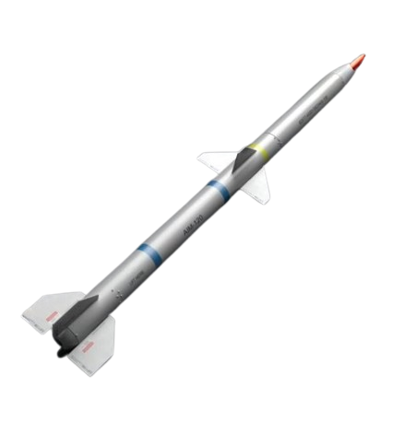
MODULE LIST
ABSTRACT
IDEA/APPROACH DETAILS
FLOW CHART
METHODOLIGIES & ALGORITHMS FOCUSED
ANALYSIS OF THE PROJECT
EXPECTED OUTCOME
SOCIAL RELEVANCE
DEMONISTRATION SCREEN
CONCLUSION

Slide 4
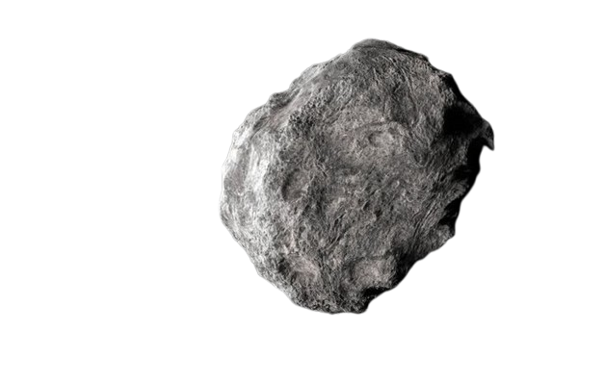
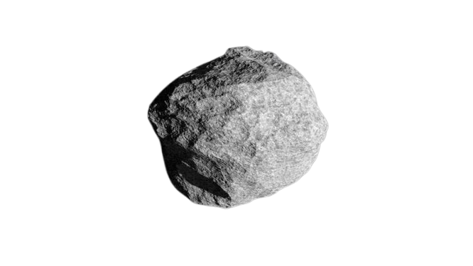

ABSTRACT
The Stratospheric Dust Analysis Rocket is a student-driven project focused on high-altitude exploration.​
​
This mission is a step toward sustainable, accessible, and impactful aerospace innovation, making space research more inclusive for future pioneers like me.​

Slide 5
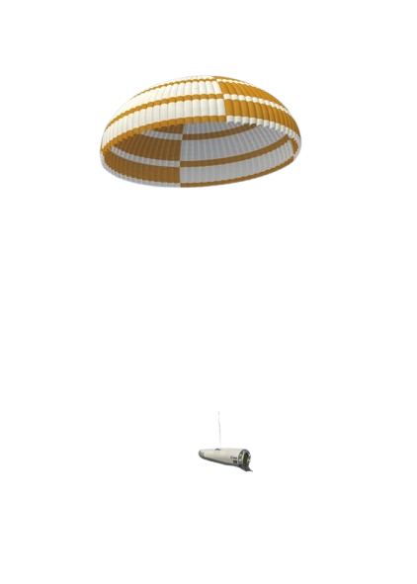
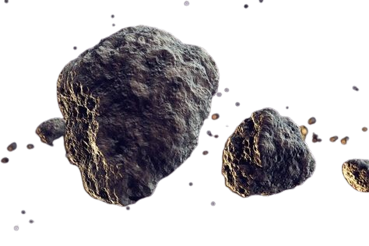
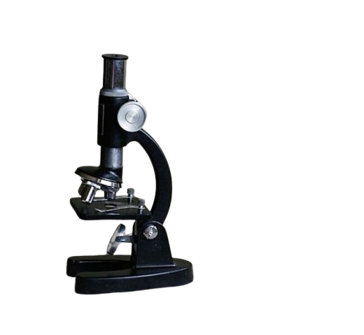
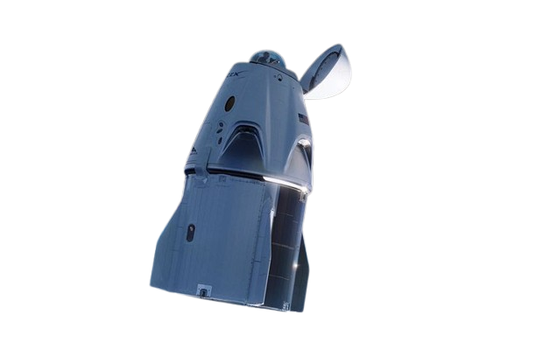
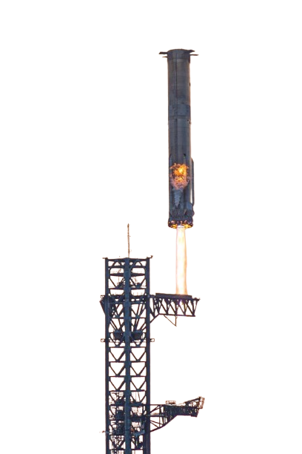
IDEA/APPROACH DETAILS
Thought Trigger: Concerned about Earth's pollution, I began exploring its causes.
Inspiration: Questioned, "Why not create an eco-friendly environment by analyzing atmospheric pollutants?“
Project Goal: Collect and analyze stratospheric dust to understand pollution and promote a cleaner environment.

Slide 6
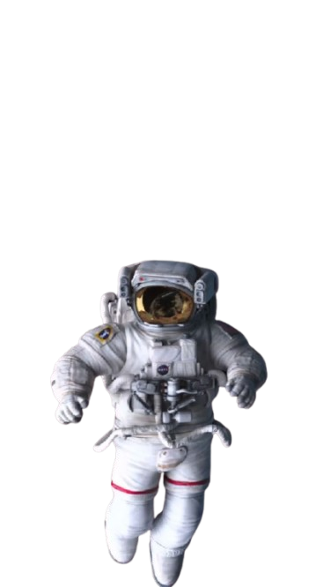
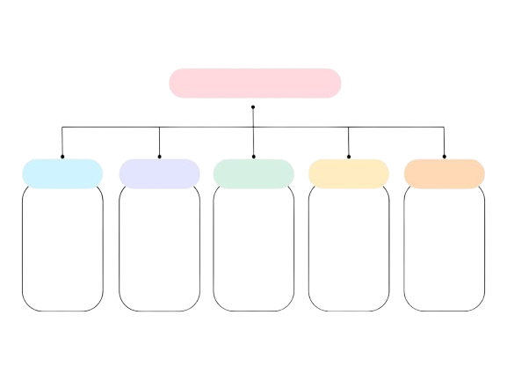
FLOW CHAT
Step 1
Step 2
Step 3
Step 4
Step 5
Rocket Launch
Payload Deployment
Sample Collection
Safety Landing
Lab
Analysis

Slide 7


METHODOLIGIES & ALGORITHMS FOCUSED
Trajectory Calculation: Predicting the rocket's path and landing zone.
Sampling Mechanism: Pre-tested dust collection at target altitude.
Data Analysis: Processing sensor data to analyze dust composition.
Recovery System: Automated parachute deployment for safe recovery.
Impact Assessment: Evaluating atmospheric pollution levels.

Slide 8
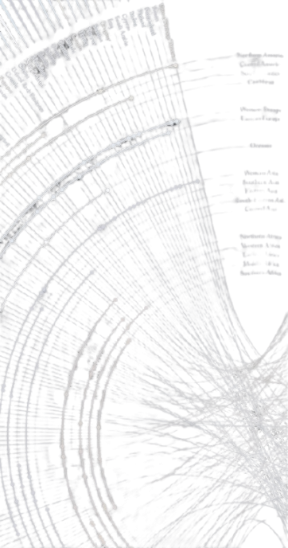


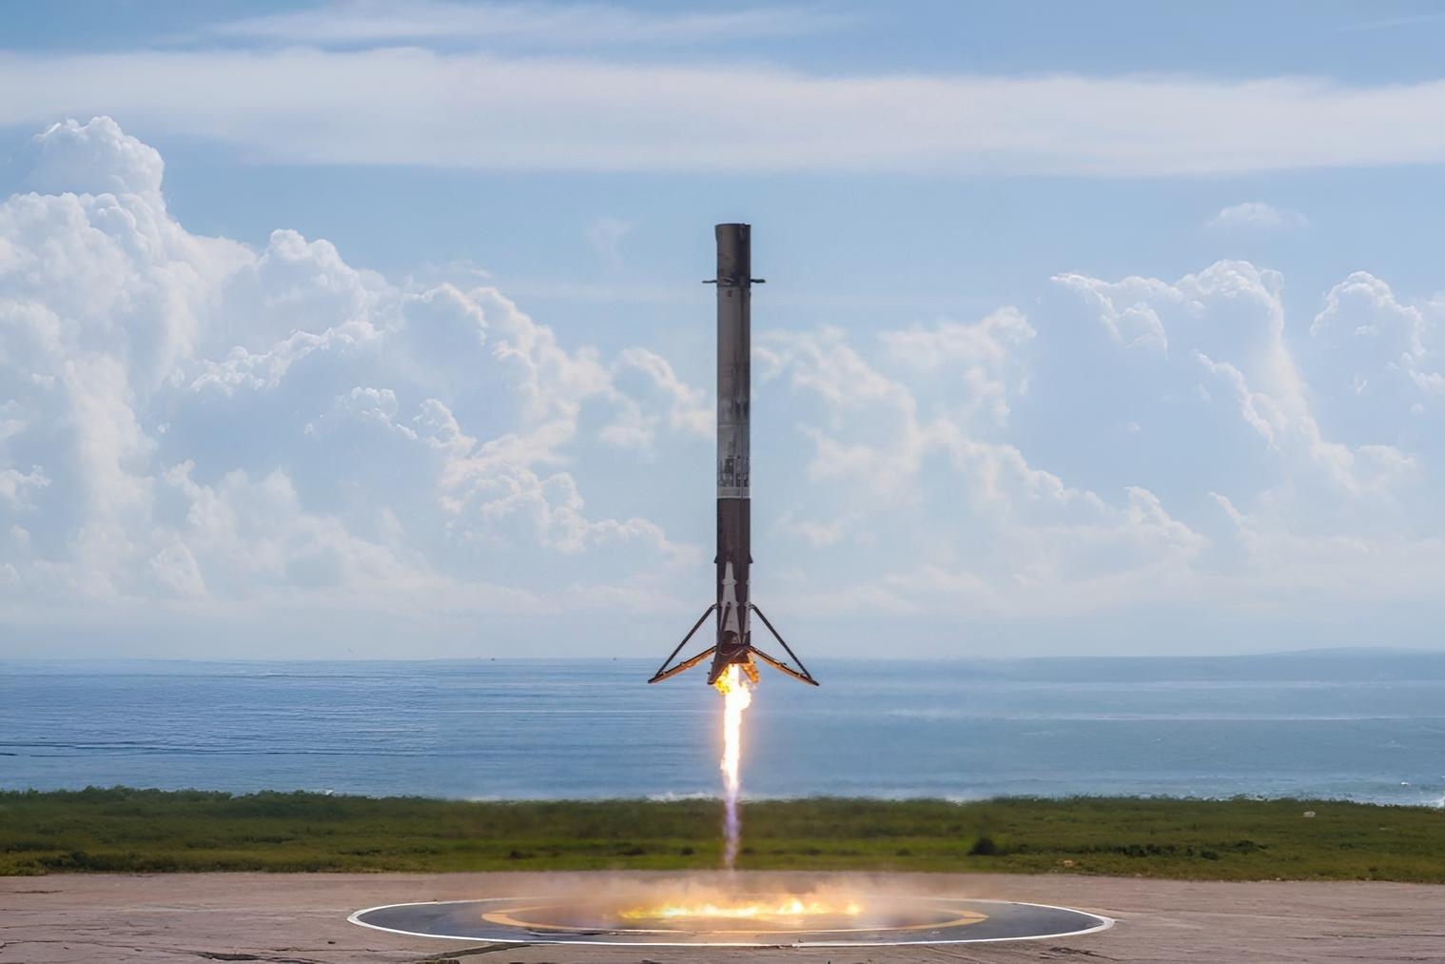

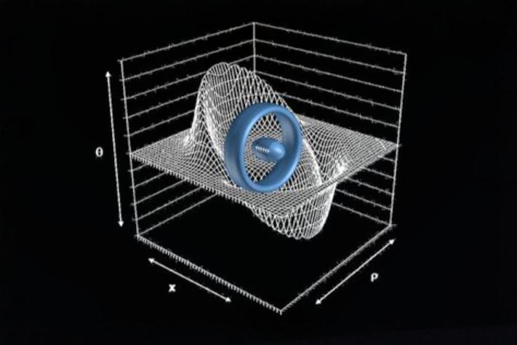
ANALYSIS OF THE PROJECT
Discovery new information.
Establish a practical method.
Encourage educational institutes.
Provide valuable data for environmental studies.
Showcase a successful model for student-led scientific innovation in aerospace.
Data Interpretation
Budget Friendly
Reusable Rocket
Eco-Friendly Impact
Proving Research Feasibility

Slide 9
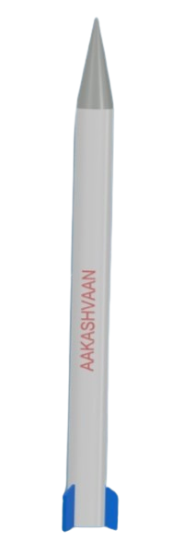
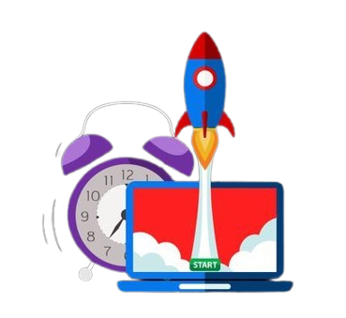





EXPECTED OUTCOME
Discovery new information.
Establish a practical method.
Encourage educational institutes.
Provide valuable data for environmental studies.
Showcase a successful model for student-led scientific innovation in aerospace.

Slide 10
SOCIAL RELEVANCE
Promotes awareness about atmospheric pollution and its impact on health and the environment.
Encourages hands-on learning and scientific curiosity among students and young researchers.

Slide 11

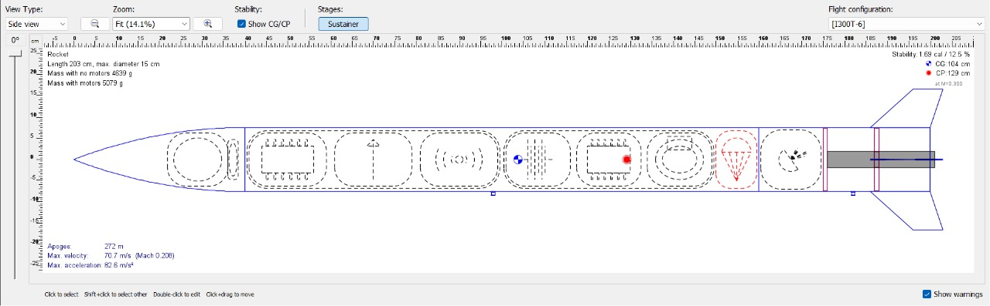
DEMONSTRATION SCREEN
Conceptual-design of our Rocket

Slide 12
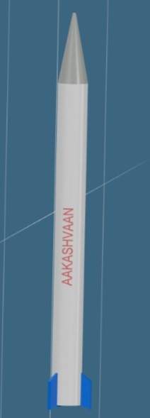
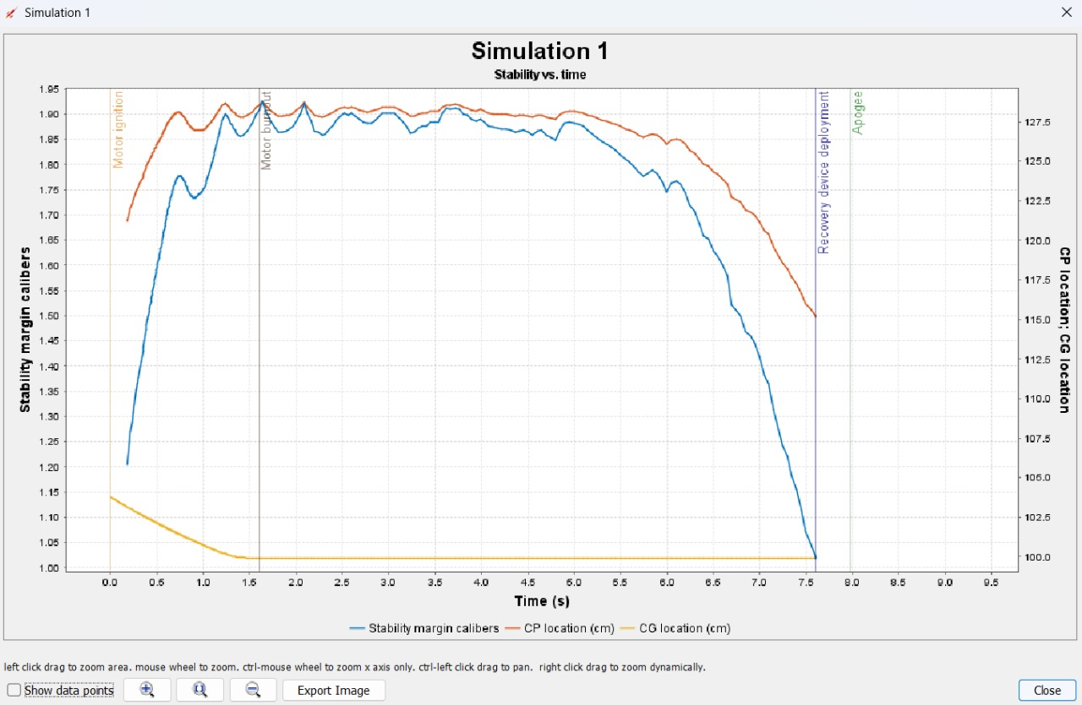
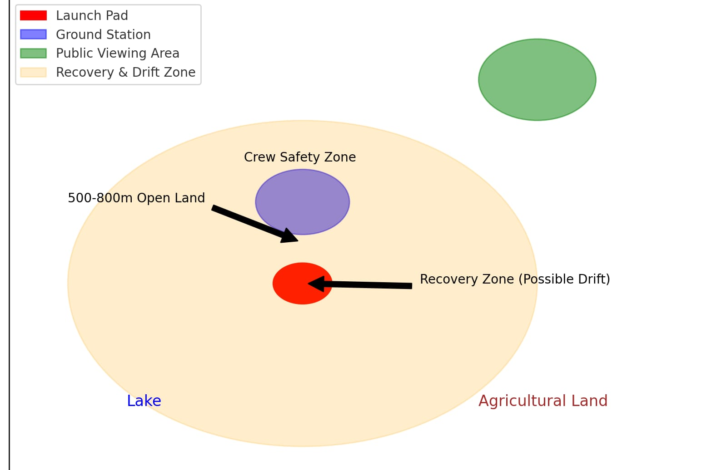
Flight Stability Simulated Margine graphical
Ground Control – Launch Site Safety Measures

Slide 13
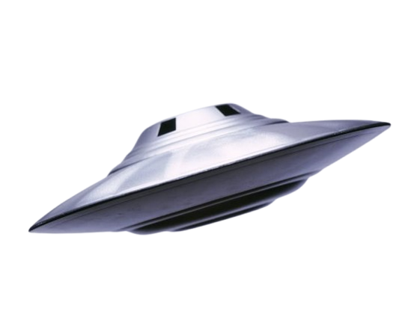
It is a conceptual design of our rocket that we are going to turn into reality.
Our rocket is 2m tall and 150mm diameter.
It is capable to achive the speed of Mach .071.

Slide 14
CONCLUSION
“From the atmosphere to understanding,
we capture the unseen to reveal the unknown”
~ Arun A

Slide 15
THANK YOU !

